Slide 1
AI in RTS game
https://deepmind.com/blog/alphastar-mastering-real-time-strategy-game-starcraft-ii/
https://www.engadget.com/2019/01/24/deepmind-ai-starcraft-ii-demonstration-tlo-mana/
https://www.techspot.com/news/78431-human-player-finally-beat-deepmind-alphastar-ai-starcraft.html
Third link includes a 2 hours video of the top player MaNa versus AI
yleung_DS6303_407
2019-FEB-07

Slide 2
StarCraft 2 –Blizzard Entertainment https://wcs.starcraft2.com/en-us/about/
Why is it difficult to teach AI to play RTS (real-time strategy) game?
Dynamic
Unlike any turn based games such as chess, both players are executing commands simultaneously
In pro tournaments, players issue and execute upwards of hundreds of commands per minute
Goal Planning
Mix and balance of macro economics and micro management
Limited and Fragmented Information
RTS games have a blind condition in PvP or PvAI.
Can’t see what the other player or DeepMind (Alphastar) is doing.
No best strategy

Slide 3
Alphastar
Supervised Learning Phase
Learn basics by imitation
Analyze strategies from actual PvP games
Learn by replays
Play against other players in league match
AI vs AI
Alphastar trained against the “Elite” level SC2 AI
Reinforced Learning Phase
Continuous game play (equivalent of a 200 years continuously game time)
Multiple agents pitched against each other for more data
Analyze strategies and outcomes
“Cheesing ” opponent (zerg /templar rush, proxy hatching) in early stage of the reinforced learning
Notes:
In MaNa vs Alphstar, the win condition was to eliminate all bases and units (total victory). No GG’ing (good game, surrender) allowed as in PvP or ladder matches

Slide 4
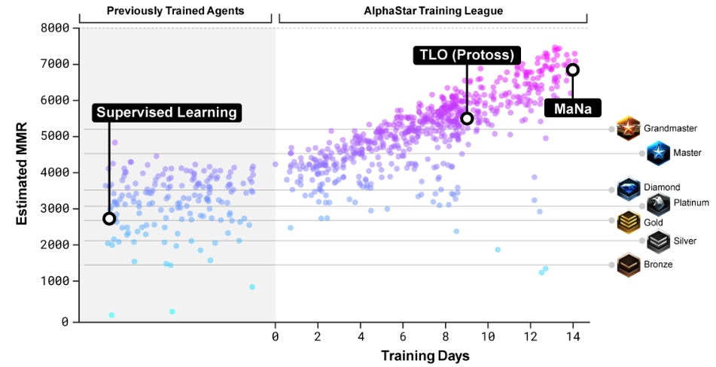
Alphastar

Slide 5
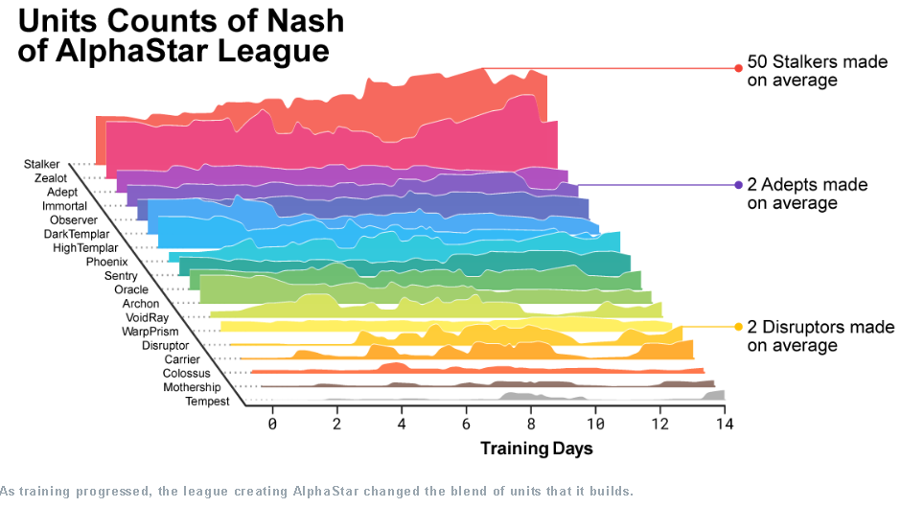
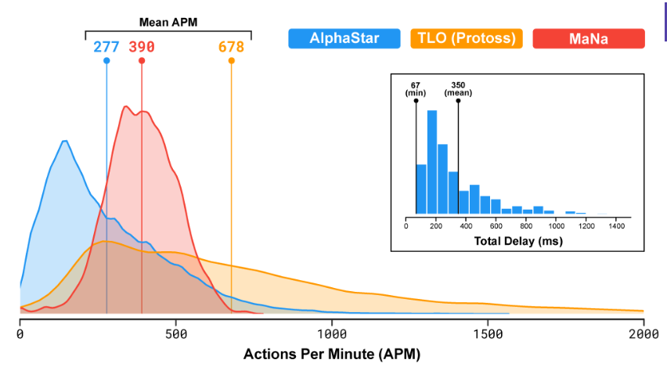
Alphastar

Slide 6
GIGO
The quality of the AI is only as good as the information you supply it with
Alphastar observed and played against 2 of the top pro level players from the SC2 tournament circuits
Notes:
https://liquipedia.net/starcraft2/MaNa Played against the AI, lost 5-0 and won against Alphastar on 2019-January-24

